Slide 1

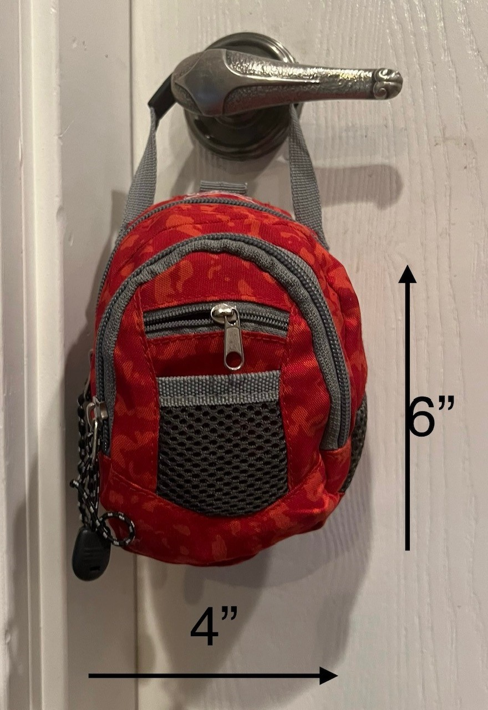
Let’s Talk Mini Go Bags
Joanne Milo, Founder, T1Dto100, T1D over 61 years
6 May 2026

Slide 2

Why or Why Not?
Most people won’t build a go-bag ...
It feels like work and doesn’t feel urgent
I don’t know what to include
It feels overwhelming
I assume hospitals will have everything I need
Many folks avoid thinking about emergencies

Slide 3
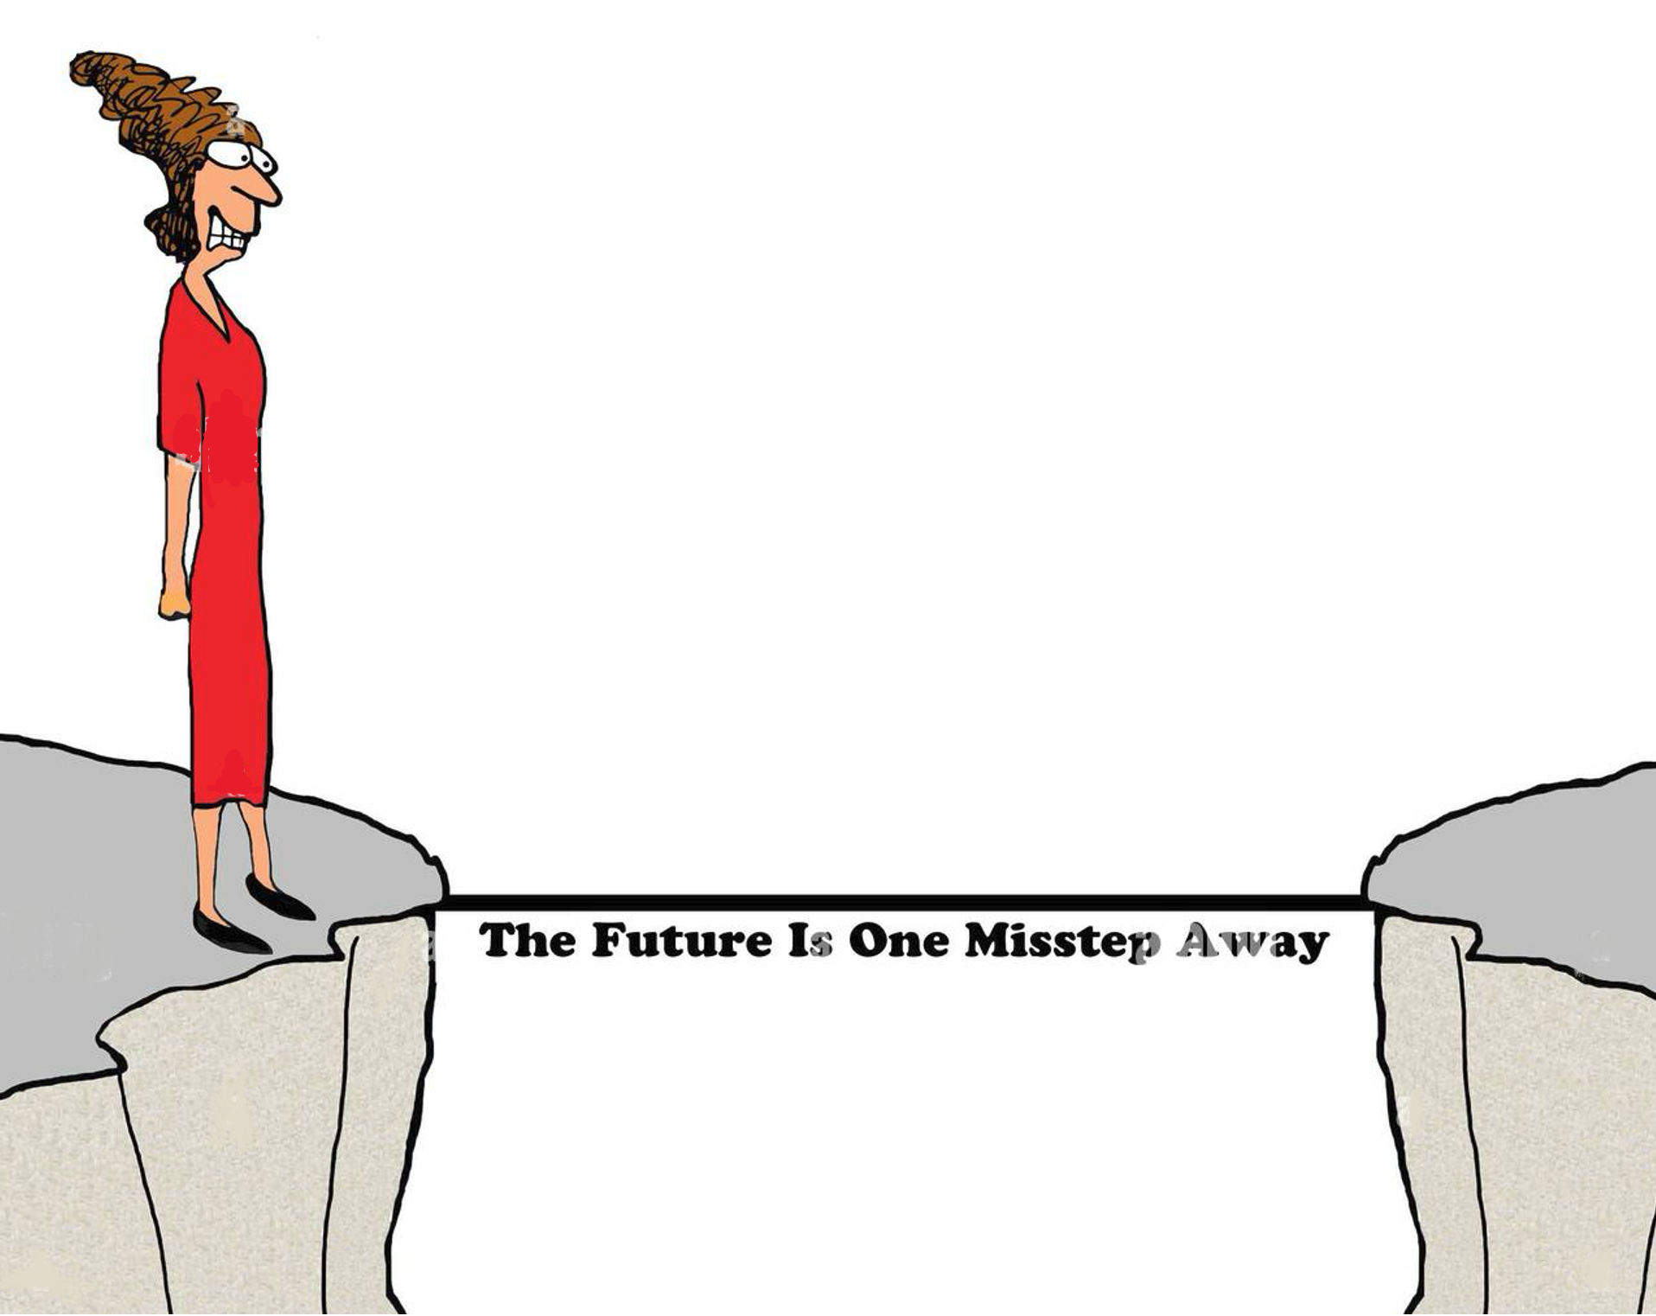
The Question
Are you a risk taker?

Slide 4
The Poll
Do you have a Mini Go Bag?
If not, please share why you don’t have one
What would encourage you to make your Go Bag?

Slide 5
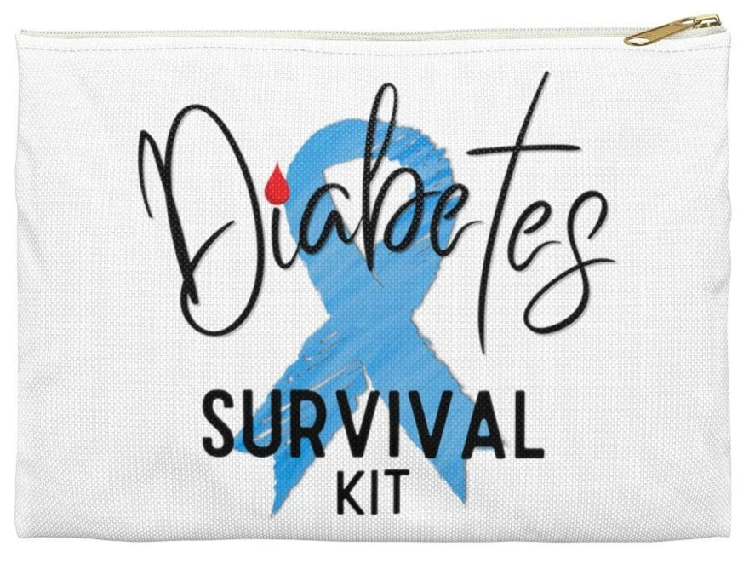
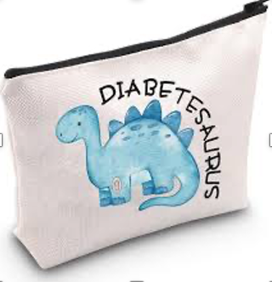
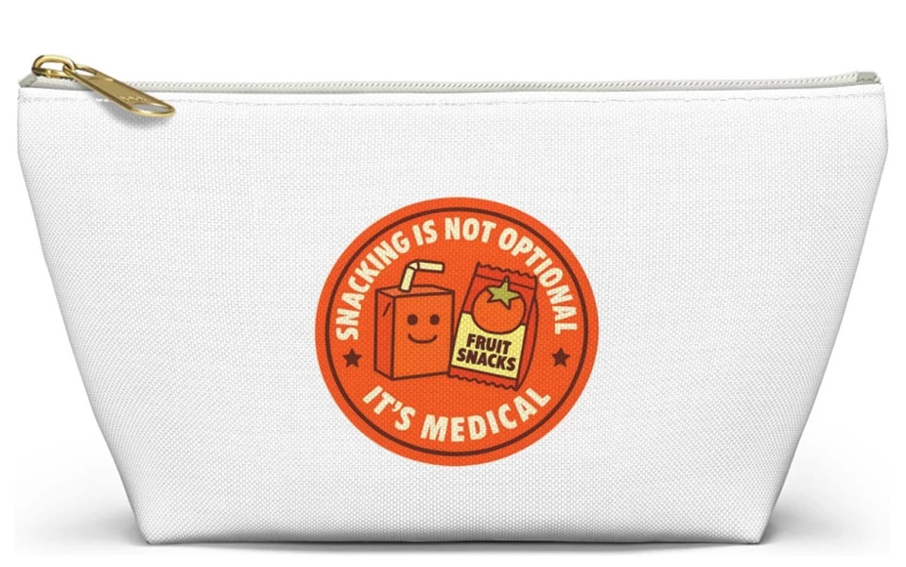
A Parade of Go Bags
OR
On the Go Kit
Peace of Mind
Little Lifesaver
Happy Bag
My Sidekick

Slide 6
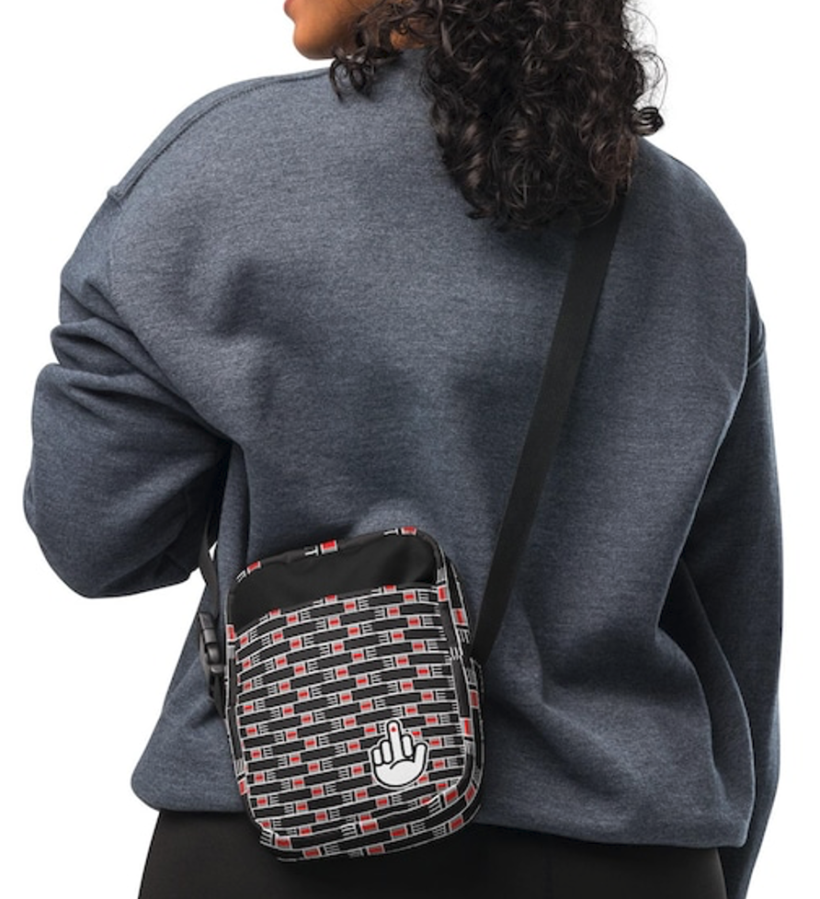

An Interesting Go Bag Patch

Slide 7
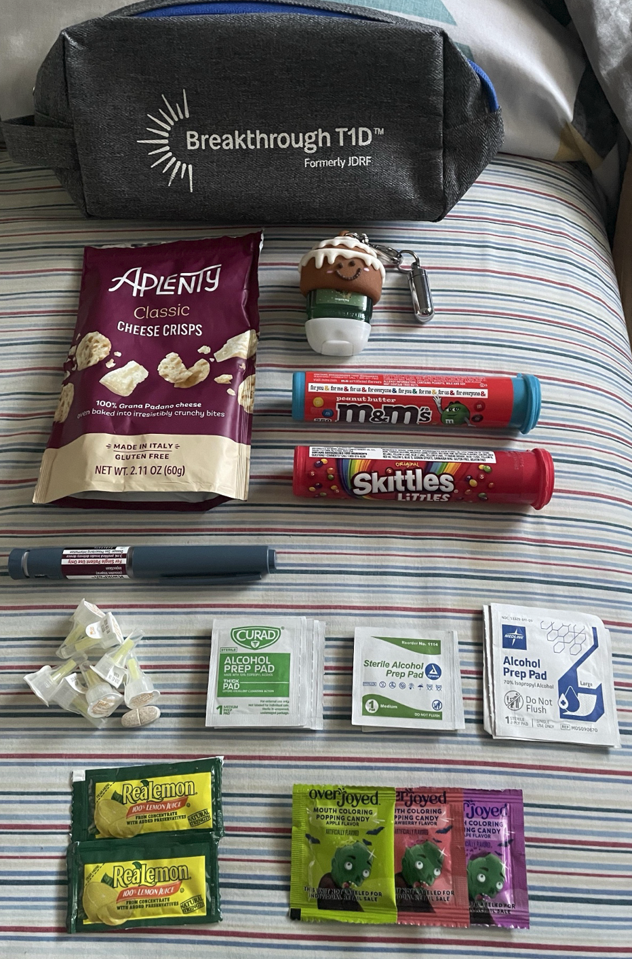
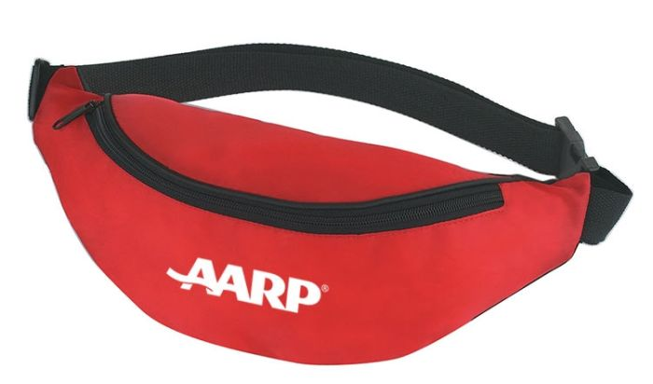
Pre-Filled Go Bag

Slide 8
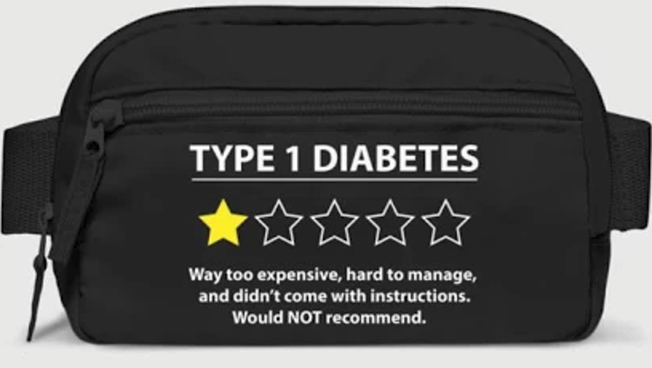
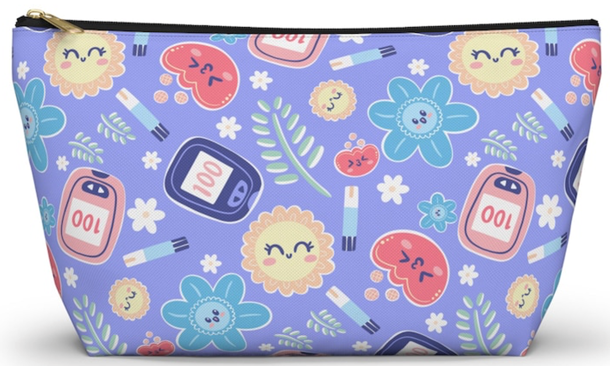

Fun with Go Bags

Slide 9
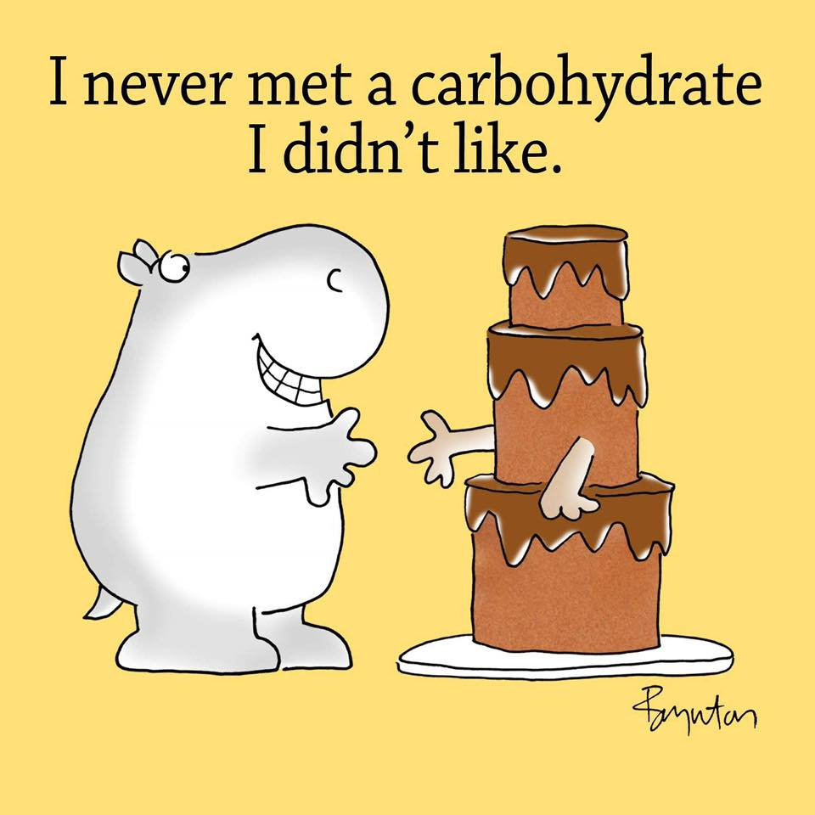
Just Because …

Slide 10
Thank You!
Thank you for joining us. Your presence, your questions, and your experience make this community stronger.
Where to Find Us
Website: T1Dto100.com
Facebook Group: T1D to 100 — Aging with Type 1 Diabetes
Instagram: @T1Dto100
Email: hello@T1Dto100.com
YouTube: www.youtube.com/@T1Dto100

